Slide 1
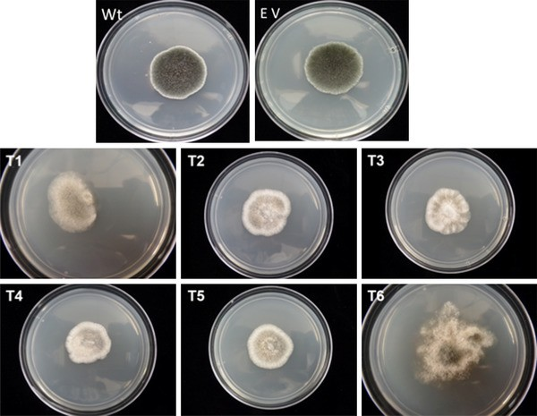
Colony phenotypes of Slafractonia leguminicola wild type and IRT pks1 transformants. Wt wild type S. leguminicola and E V: wild-type S. leguminicola transformed with empty vector (pSilent-1) after 3 days of growth on PDA, IRT pks1 transformants (T1–T6) after 5 days of growth on PDA after transformation with the silencing vector pSilentPKS1-AS

